Slide 1
MULTIMEDIA TECHNOLOGY
CHAPTER ONE
INTRODUCTION TO MULTIMEDIA

Slide 2
Multimedia
The notion of Multimedia
Consists of two words:
Multi (Latin)= many; much;
Medium (Latin) = An intermediate substance through which something is transmitted or carried on.

Slide 3
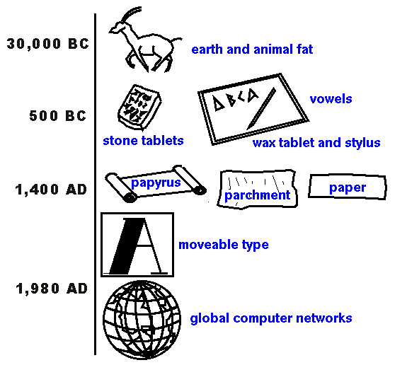
History Of Multimedia
What can we say about the evolution of media that has taken place for thousands of years?
Since the dawn of time, people have had the need to communicate with one another
This created what we called as communication media
http://www.december.com/present/mediaev.html

Slide 4
What is Multimedia?
Multimedia can be any combination of text, graphics, sound, animation and video, to effectively communicate ideas to users delivered by computer or any other electronic devices.

Slide 5
What is Multimedia? (Other definition)
‘Multimedia is any combination of text, art, sound, animation, and video. It is delivered to the user by electronic or digitally manipulated means. A multimedia project development requires creative, technical, organizational, and business skills.’
Tay Vaughan
Multimedia : Making it work 7th Ed.

Slide 6
What is Multimedia? (Other definition)
‘“Multimedia is the presentation of a (usually interactive) computer application, incorporating media elements such as text, graphics, video, animation and sound on computer.”
Stephen McGloughlin
Multimedia: Concepts & Practice

Slide 7
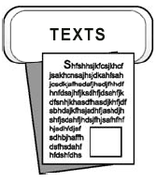
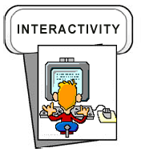
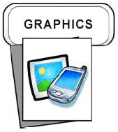
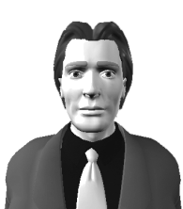


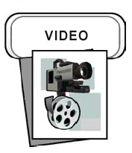
Multimedia Building Block
Digital environment
USER
Elements of Multimedia

Slide 8
Why Multimedia?
Ease of use
Interaction and better retention
Better understanding
Cost effectiveness
More fun = greater efficiency

Slide 9
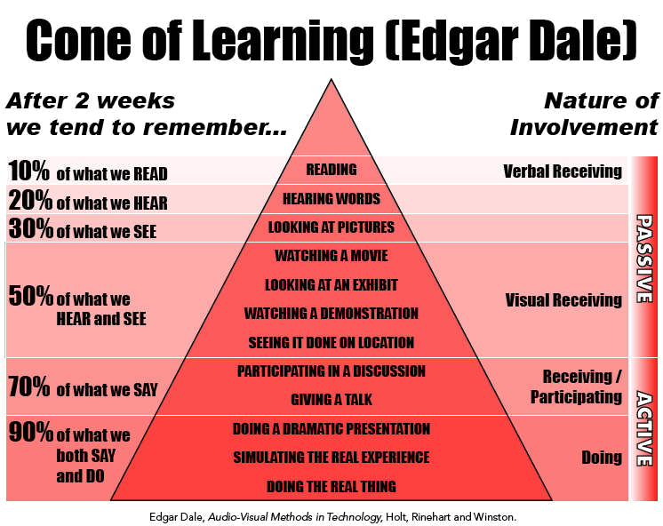

Slide 10
Types of Multimedia
Linear Multimedia
  Users have very little control over the presentation
Nonlinear/Interactive Multimedia
  Users dictate the flow of delivery. User control the flow of the show.

Slide 11
Types of Multimedia:
(1)Linear Multimedia
  The users sit back and watches the presentation
  The presentation normally plays from the start to end or even loops continually to present the information.
  A movie is a common type of linear multimedia

Slide 12
Types of Multimedia:
(2)Interactive Multimedia
  The users control the delivery of elements – to control the what and when. Users have the ability to move around or follow different path through the information presentation.
  Advantage: complex domain of information can be presented.
  Disadvantage: users might lost in the massive “information highway”.
  Useful for: encyclopedia, education, training and entertainment.

Slide 13
Delivering and Using Multimedia
The primary media for delivering multimedia projects are:
  Compact disc read-only (CD-ROM).
  Digital Versatile Disc (DVD) / Blu-ray Disc
Multimedia Projects can also be delivered online (webs) and through PDAs/Hand-held Devices

Slide 14
Application of Multimedia
Business - Business applications for multimedia include presentations training, marketing, advertising, product demos, databases, catalogues, instant messaging, and networked communication.
Schools - Educational software can be developed to enrich the learning process.

Slide 15
Application of Multimedia
Home - Most multimedia projects reach the homes via television sets or monitors with built-in user inputs.
Public places - Multimedia will become available at stand-alone terminals or kiosks to provide information and help.

Slide 16
Summary
Multimedia is the combination of text, graphics, sound, animation and video, to effectively communicate ideas to users delivered by computer.
Multimedia projects can be linear or nonlinear.
Multimedia projects are often stored on CD-ROM or DVDs. They can also be hosted on the Web.
Multimedia is widely used in business, schools, public places, and at home.

